Slide 1
RESIDENTS PERCEPTION SURVEY AUTUMN 2018
Scott Lawrence| Daniel Morris Opinion Research Services
February 2019

Slide 2
Presentation
Methodology
Putting results in context
Key Findings
Satisfaction with area
Resident concerns
Satisfaction with Council
Barking & Dagenham as a community
Conclusions

Slide 3
Methodology
1,000 telephone interviews with local residents
All adults (18+)
Representative cross-section of local population
Approx. 20 minutes long
Quotas set on age, gender, ethnicity and working status.
Fieldwork conducted between 1st October and 6th December 2018
Questionnaire similar to 2015, 2016 and 2017

Slide 4
Reason for results
The results show a decline in resident satisfaction
This is consistent with the trend nationally of declining performance over the past few years
Neighbouring boroughs have also seen a decline
This may in part be due to the…
Current environment given the uncertainty surrounding Brexit
Economic and political situation globally
Volume of knife crime incidents in London highlighted by the media
Low confidence in the police has had an effect on the results
Whilst perception isn’t great, actual performance data shows a different picture

Slide 5
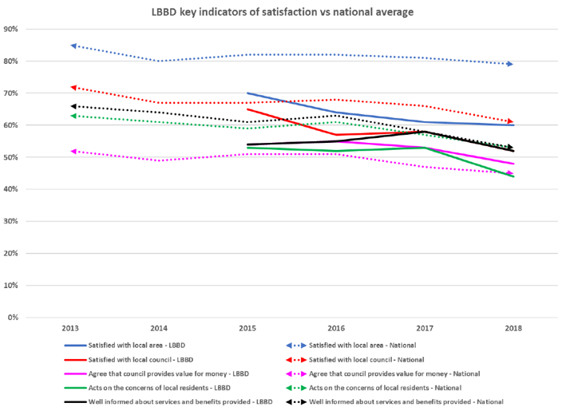
LBBD vs National
The trend shows that results for residents surveys have been going down year on year nationally across the headline measures.
LBBD’s results are consistent with the trend seen nationally.

Slide 6
Satisfaction with local area is similar to last year
Three fifths (60%) are satisfied with Barking & Dagenham as a place to live
Downward trend over last four years
Also significantly lower than the National (78%) average
More satisfied
Black ethnic group (change from Asian ethnic group in 2017)
Less satisfied
White British ethnic group (same as 2017)
Satisfaction with local area |  | 2015 | 2016 | 2017 | 2018
 | Satisfied | 70% | 64% | 61% | 60%
 | Dissatisfied | 21% | 24% | 25% | 28%
QB1. Overall how satisfied or dissatisfied are you with your local area as a place to live?
Unweighted Base: 998 respondents
Notes:
More satisfied:
Black ethnic group (67% vs 60%)
Less satisfied:
- White British ethnic group (53% vs 60%)

Slide 7
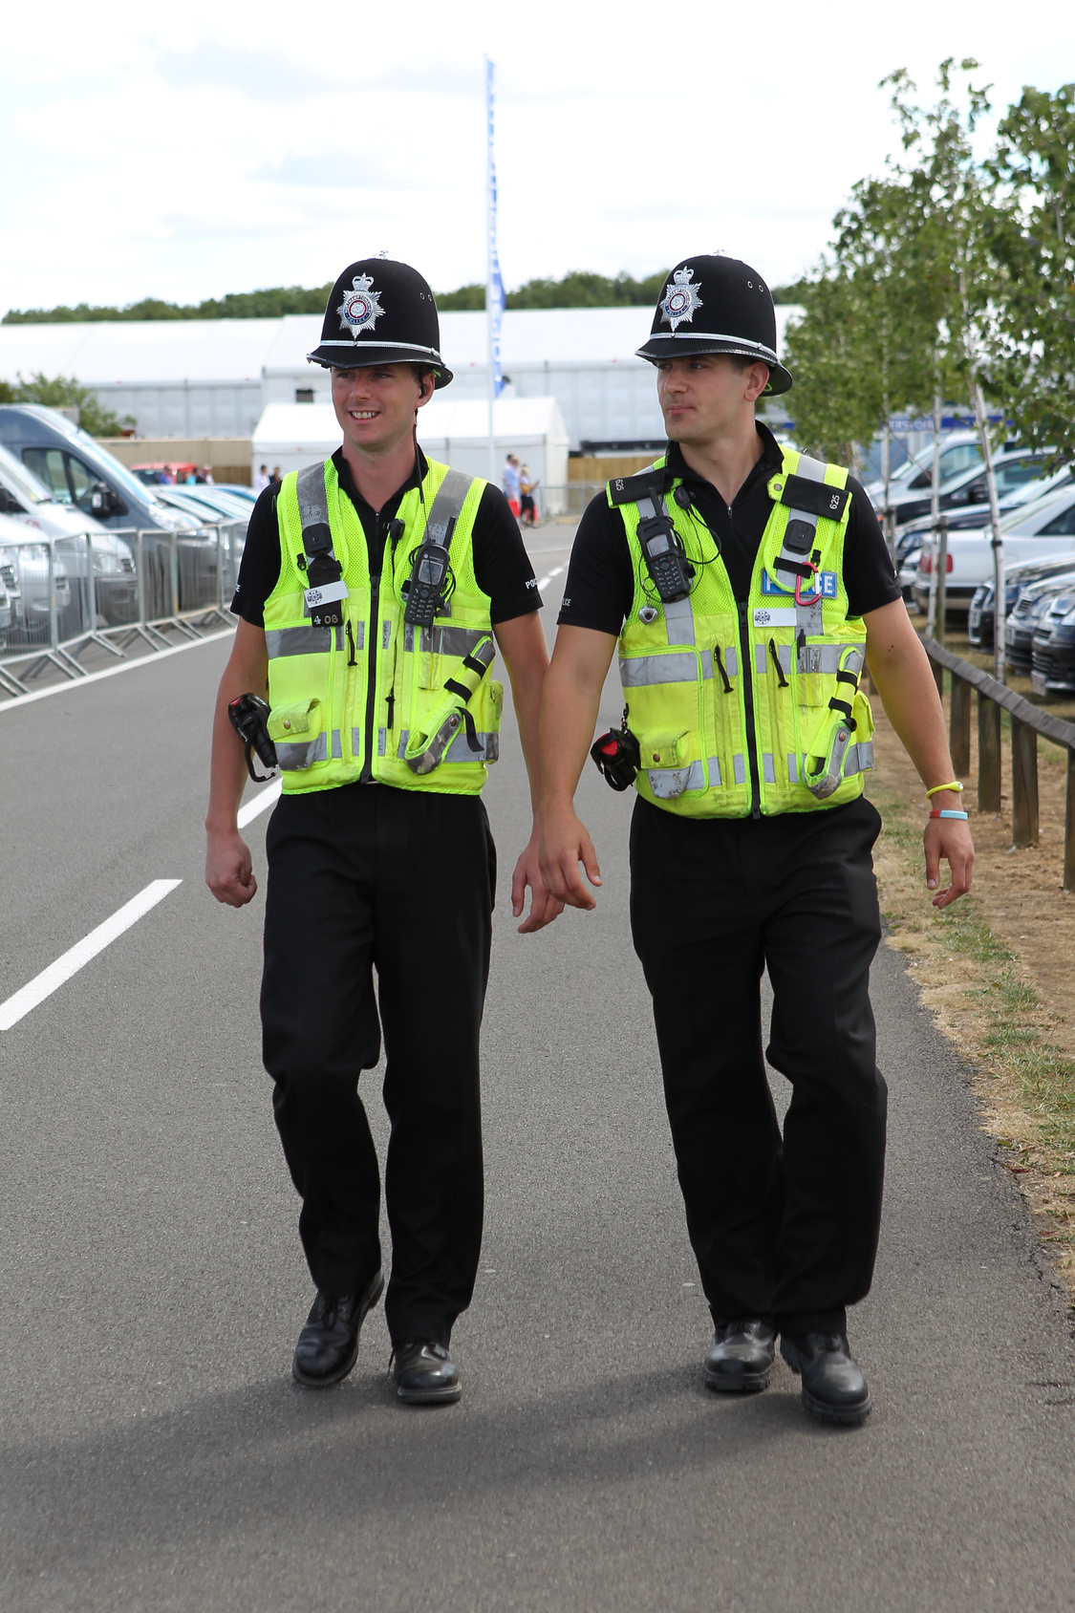
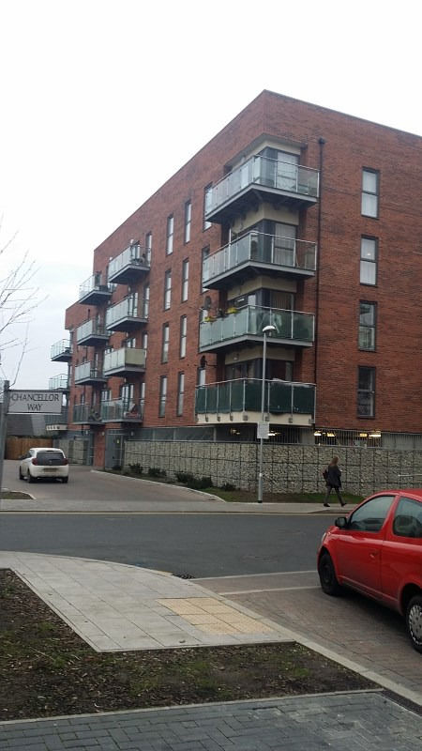
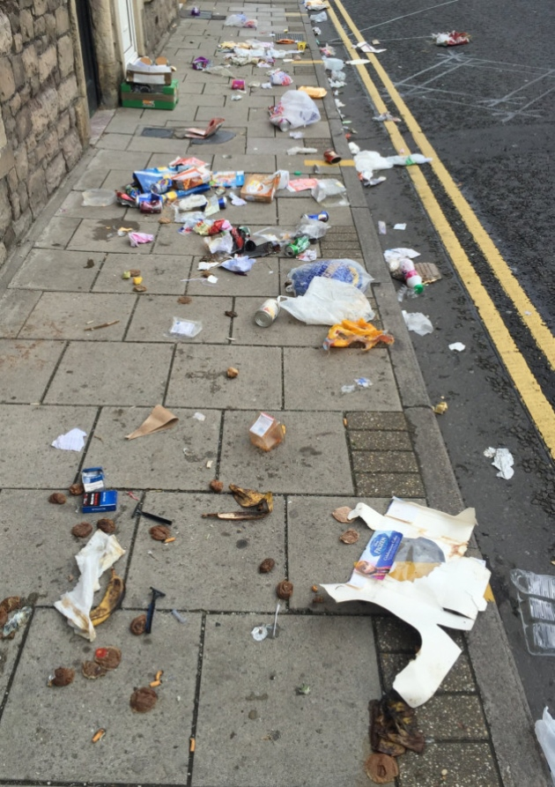
Things people are most concerned about
24%
Litter and dirt in the streets
55%
Crime
29%
Lack of affordable housing
29%
Lack of affordable housing
24%
Condition of roads / pavements
QB8. Of these which three things are you are you personally most concerned about? (Unweighted Base: 975 respondents)

Slide 8
Growing concern about crime and roads/pavements
People were asked what they were concerned about and then, the top THREE things they were most concerned about
When compared with last year, there is a growing concern about crime (+5%) and condition of roads/pavements (+5%)
But less concern about litter/dirt in the streets (-5%) and lack of jobs (-4%)
TOP CONCERNS
TOP CONCERNS
QB7. Are you personally concerned about any of the following? (Unweighted Base: 1,000 respondents)
QB8. Of these which three things are you are you personally most concerned about? (Unweighted Base: 975 respondents)

Slide 9
Top 4 Concerns: The 4-Year Trend
Year on year increase with concern about crime.
Concern with lack of affordable housing; litter and dirt in the streets; and conditions of roads/pavements similar to 2015.
QB8. Of these which three things are you are you personally most concerned about? (Unweighted Base: 975 respondents)

Slide 10
CRIME in more depth…
Crime is still the top concern for 55% of residents, up 5% on last year and up 12% since 2016.
Perception of crime and feeling unsafe has increased nationally given the prevalence of knife crime over the past year.
To add to this confidence in the police locally is very low. This has impacted on the survey results.
Policing |  | 2016 | 2017 | 2018 | Change since 2017 | Change since 2016
 | Good | 49% | 41% | 34% | -7% | -15%
 | Poor | 25% | 34% | 41% | +7% | +16%
QB9V. What is your opinion of…Policing?
Base sizes vary
BUT…
Total notifiable offences per 1,000 residents
Lower than the London average during 2017/18
Youth victims of total notifiable offences
Lower than the London average during 2017/18
Also, total crimes down 2.5% in the 12 months to December 2018 (compared with the previous 12 months)

Slide 11
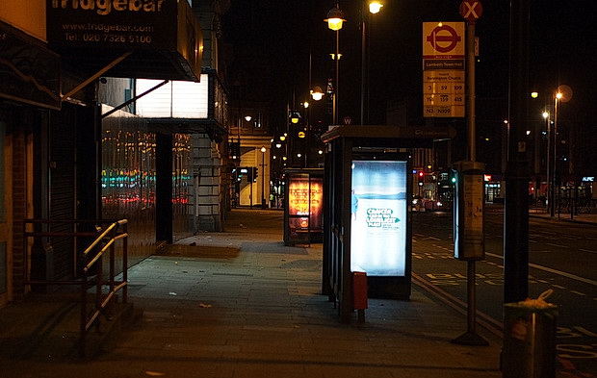
A downward trend in people feeling safe after dark
51% (2015)
49% (2016)
42% (2017)
35% (2018)
QG1b. How safe or unsafe do you feel when outside in your local area after dark?
Unweighted Base: 990 respondents

Slide 12
Three in ten now feel very unsafe outside after dark
Proportion of residents who feel safe is also significantly lower than the National average (76%)
Women, White British and those with a disability are less likely to feel safe after dark – same as 2017
Decrease is perhaps not surprising given the (extensive) media coverage of knife crime in London over the last 12 months
Similarly, there has also been a decline in the proportion of residents who feel safe during the day
79% in 2018 compared with 82% in 2017 and 85% in 2016
Barking and Dagenham residents feel less safe than the National (93%) average
Women and those with a disability are less likely to feel safe during the day
Aspiring Homemakers Mosaic group more likely to feel safe outside after dark and during the day
QG1b. How safe or unsafe do you feel when outside in your local area after dark?
Unweighted Base: 990 respondents
QG1b. How safe or unsafe do you feel when outside in your local area during the day?
Unweighted Base: 996 respondents
Notes:
Less likely to feel safe after dark:
Women (25% vs 35%)
White British (32% vs 35%)
Disability (29% vs 35%)
Less likely to feel safe during the day:
Women (75% vs 79%)
Disability (71% vs 79%)
Aspiring Homemakers:
After dark (51% vs 35%)
During the day (92% vs 79%)

Slide 13
Over half are worried about drugs, litter and fly tipping
Increase in proportion who feel people using or dealing drugs (+8%), rubbish or litter lying around (+6%), fly tipping (+5%), people being drunk/rowdy (+3%) and dog fouling (+3%) are a problem
Concern with abandoned / burnt out cars (-5%) and vandalism (-3%) has declined
All anti-social behaviour is more of a concern than nationally
93% think the council should take more action to stop ASB
G2. Thinking about this local area, how much of a problem do you think each of the following are?
Unweighted Base: Base size varies (NB: ‘fly tipping’ & ‘dog fouling’ are not part of the Crime Survey)
QG3 Do you think the Council should take more action to stop these kind of problems?
Unweighted Base: 985 All respondents

Slide 14
Reducing crime is key to encouraging people to stay
42% expect to move away in the next 5 years
Same as last year
Under 35s and those working are most likely to leave
Over two fifths (44%) say that a reduced level of crime would encourage them to stay in the area
QB5. Do you expect to move away from Barking & Dagenham within the next five years?
Unweighted Base: 941 respondents
QB6: What changes in Barking & Dagenham, if any, would make you less likely to move away? Unweighted Base: 350 respondents
Notes:
Most likely to leave
Under 35s (53% vs 42%)
Working (49% vs 42%)

Slide 15
CRIME: Key Message
THIS IS AN AREA WHICH NEEDS FIXING – KEEP LOBBYING!
Lobbying to MOPAC to address crime and safety issues for the borough, including discussions on increased visible policing, reporting hubs, knife bins and a new police station.
Agreement has been reached across the East BCU to establish an Integrated Gangs Unit (IGU).
MPS, YOS, NPS, CRC, Spark2Life and DWP have committed officers to the IGU
We've increased CCTV and improved street lighting in Barking and intend to continue this improvement across the borough
The police are carrying out daily patrols and weapons sweeps across the borough, intelligence is shared across the community safety partnership.
Safer Neighbourhood Board open public meetings (2 per year) held with MPS, Council Officers and residents to discuss areas of concern in relation to and the perception of crime.
Awarded £500,000 from the Early Intervention Youth Fund (EIYF) to deliver interventions to children and young people (CYP) to reduce levels of serious violence and crime.
Reoffending rates for young people are now better than the London average and improving for adults as well. The rate of non-domestic abuse violence with injury is down 5 per cent in the last year and burglary is also down over 6 per cent in that time. Knife crime is also down by 19 per cent in that period.
Launching Domestic Violence Commission to raise awareness and reduce the normalisation of domestic violence.
First EAST BCU Serious Violence Summit held in January 2019 to start discussions around the challenges of serious violence and areas for joined up working.

Slide 16
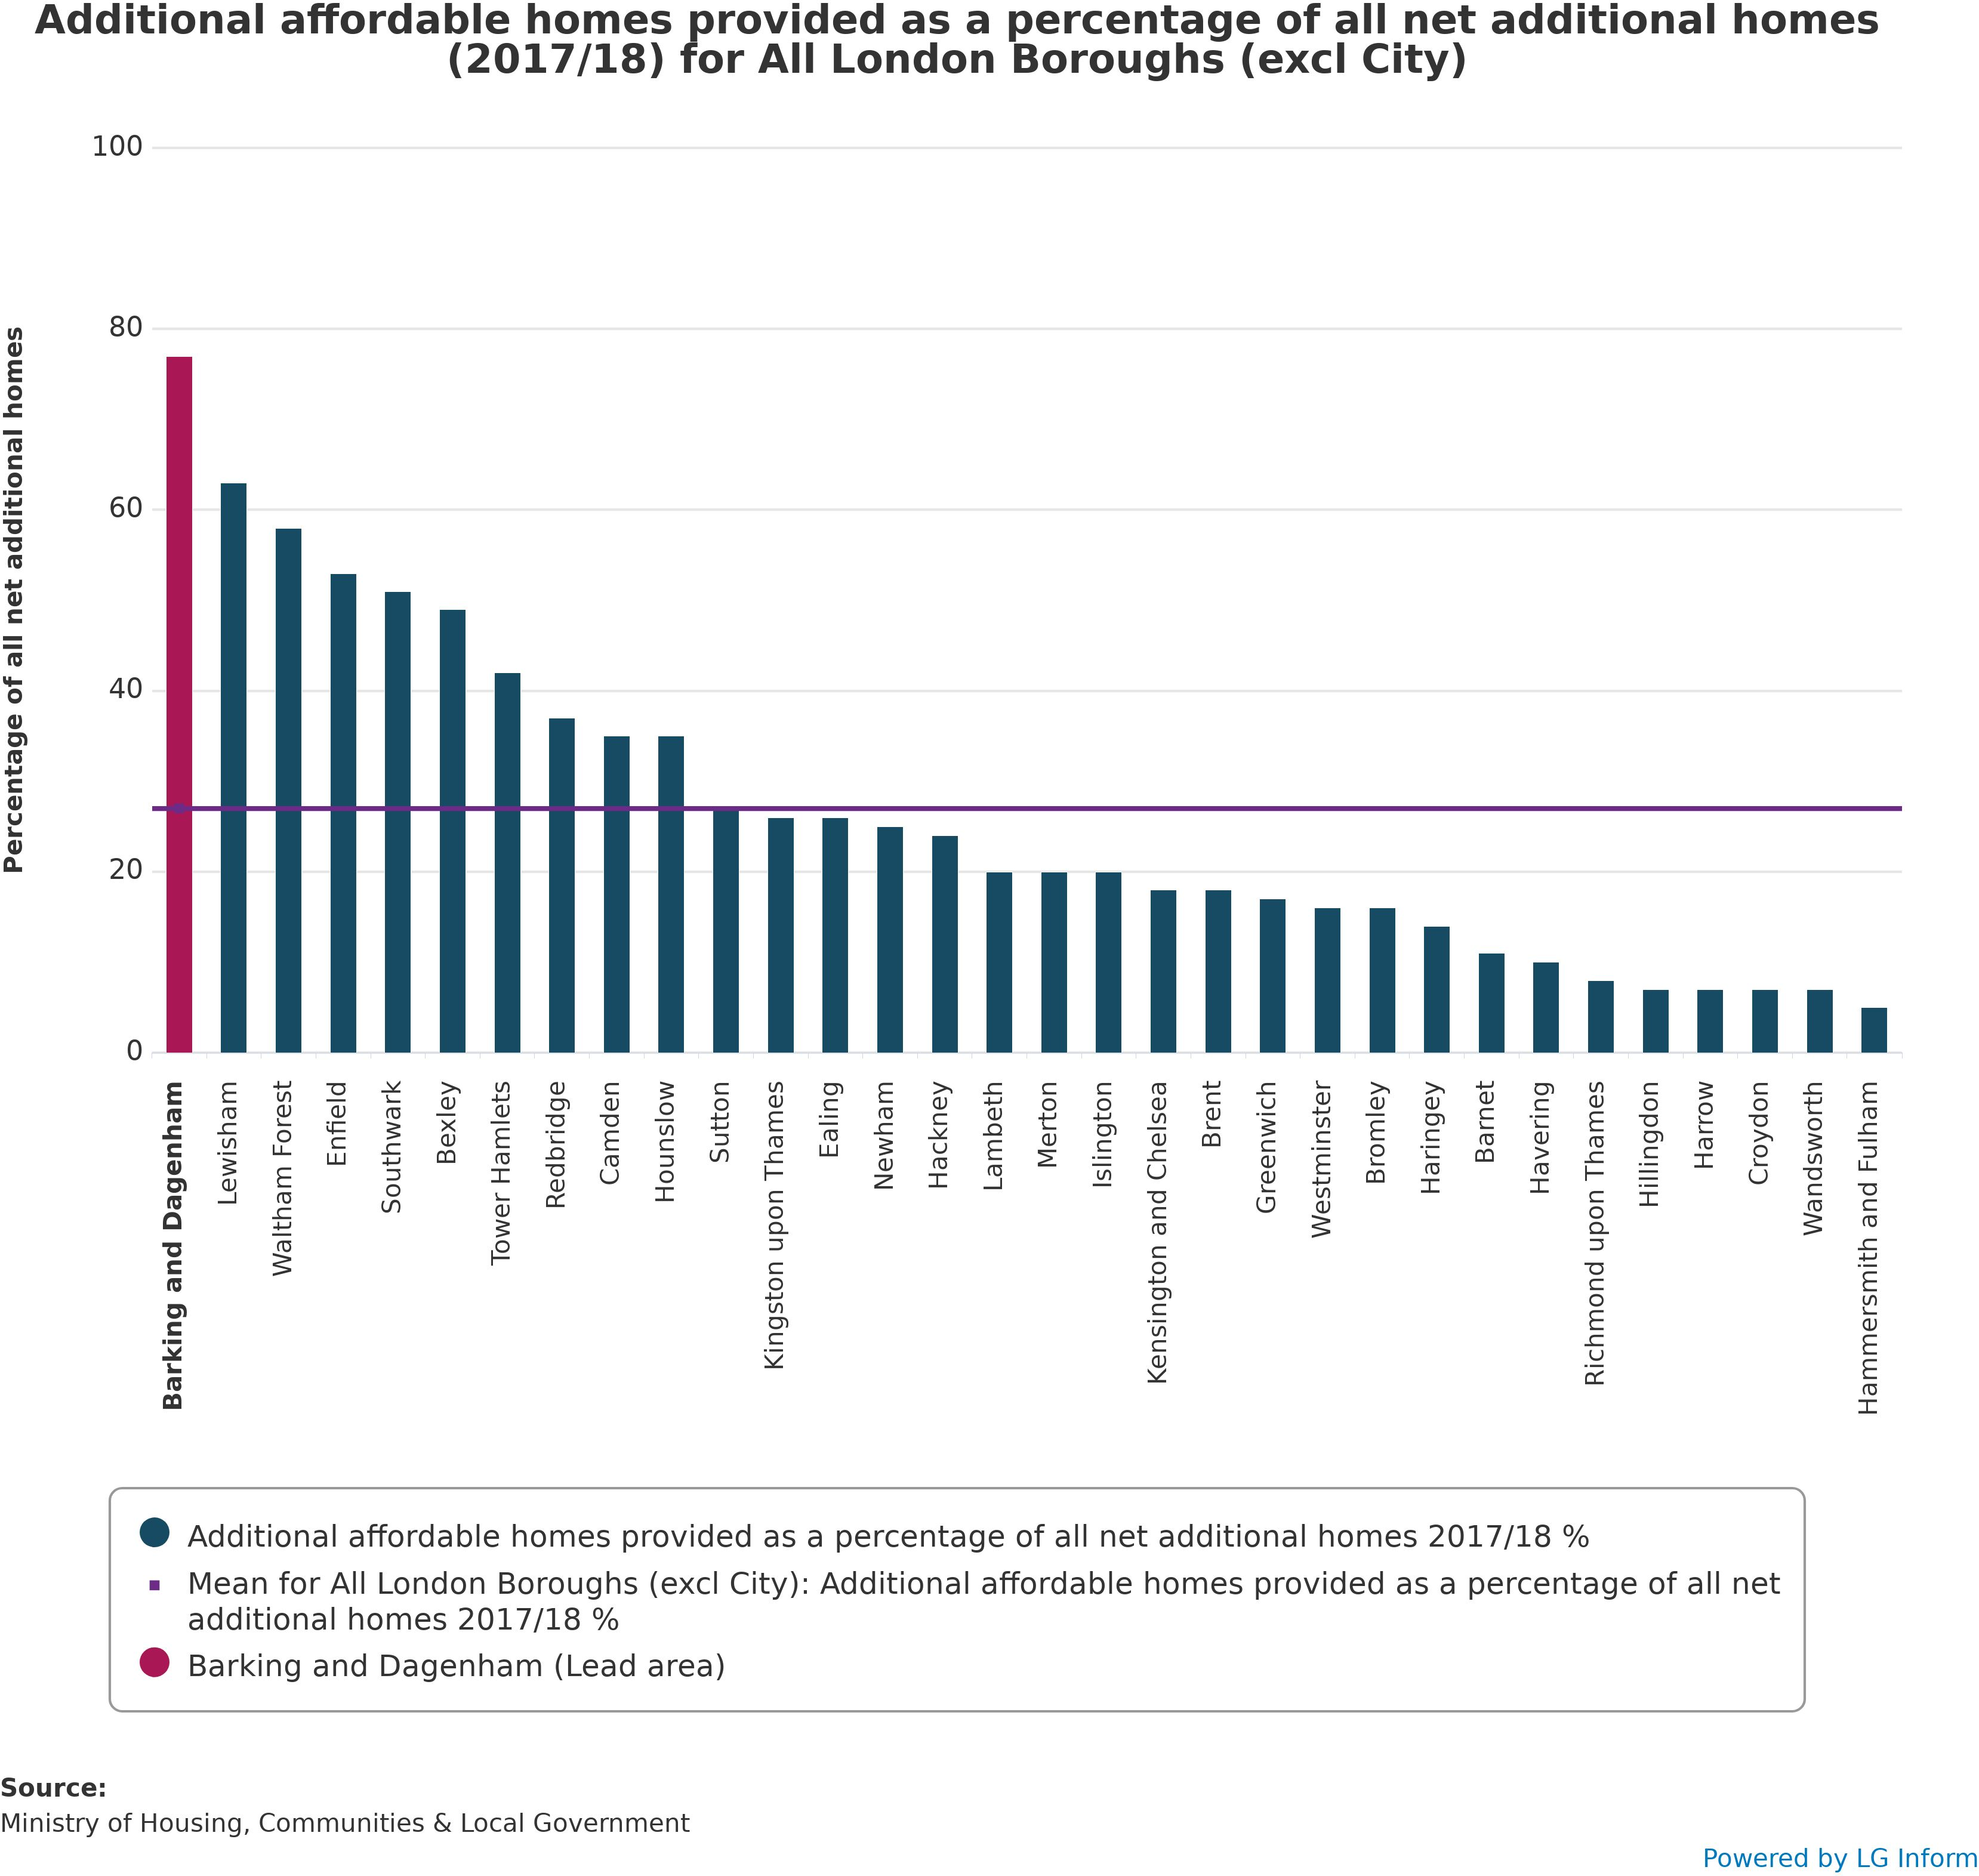
AFFORDABLE HOUSING in more depth…
Last year more than three quarters of LBBD’s new homes were affordable.
LBBD had the highest proportion in London.

Slide 17
AFFORDABLE HOUSING: Key Message
LBBD APPROACH IS WORKING – KEEP AT IT!
More new affordable homes completed and let through Reside, e.g. Weavers Quarter
The ComSol preventative approach means households at risk of homelessness are helped much earlier than before and has resulted in households owed a homelessness duty dropping from 941 in 2015/16 to 512 in 2017/18
The number of households in temporary accommodation has dropped from 1,904 in 2017/18 to just over 1,700
Action has been taken against rogue landlords and to enforce standards in the private rented sector

Slide 18
LITTER/DIRT: Key Message
THIS IS NOW LESS OF A CONCERN FOR RESIDENTS.
RIGHT TO FOCUS ON IT – KEEP AT IT!
LBBD are continuing to try and keep their streets free from litter and dirt
In December, a council clampdown on people dropping litter on the floor led to 45 fines being issued in just five days in Barking
Council’s wall of shame has been successful and has helped raise awareness
A recruitment campaign to fill positions within the service
Focus on behavioural change campaigns

Slide 19
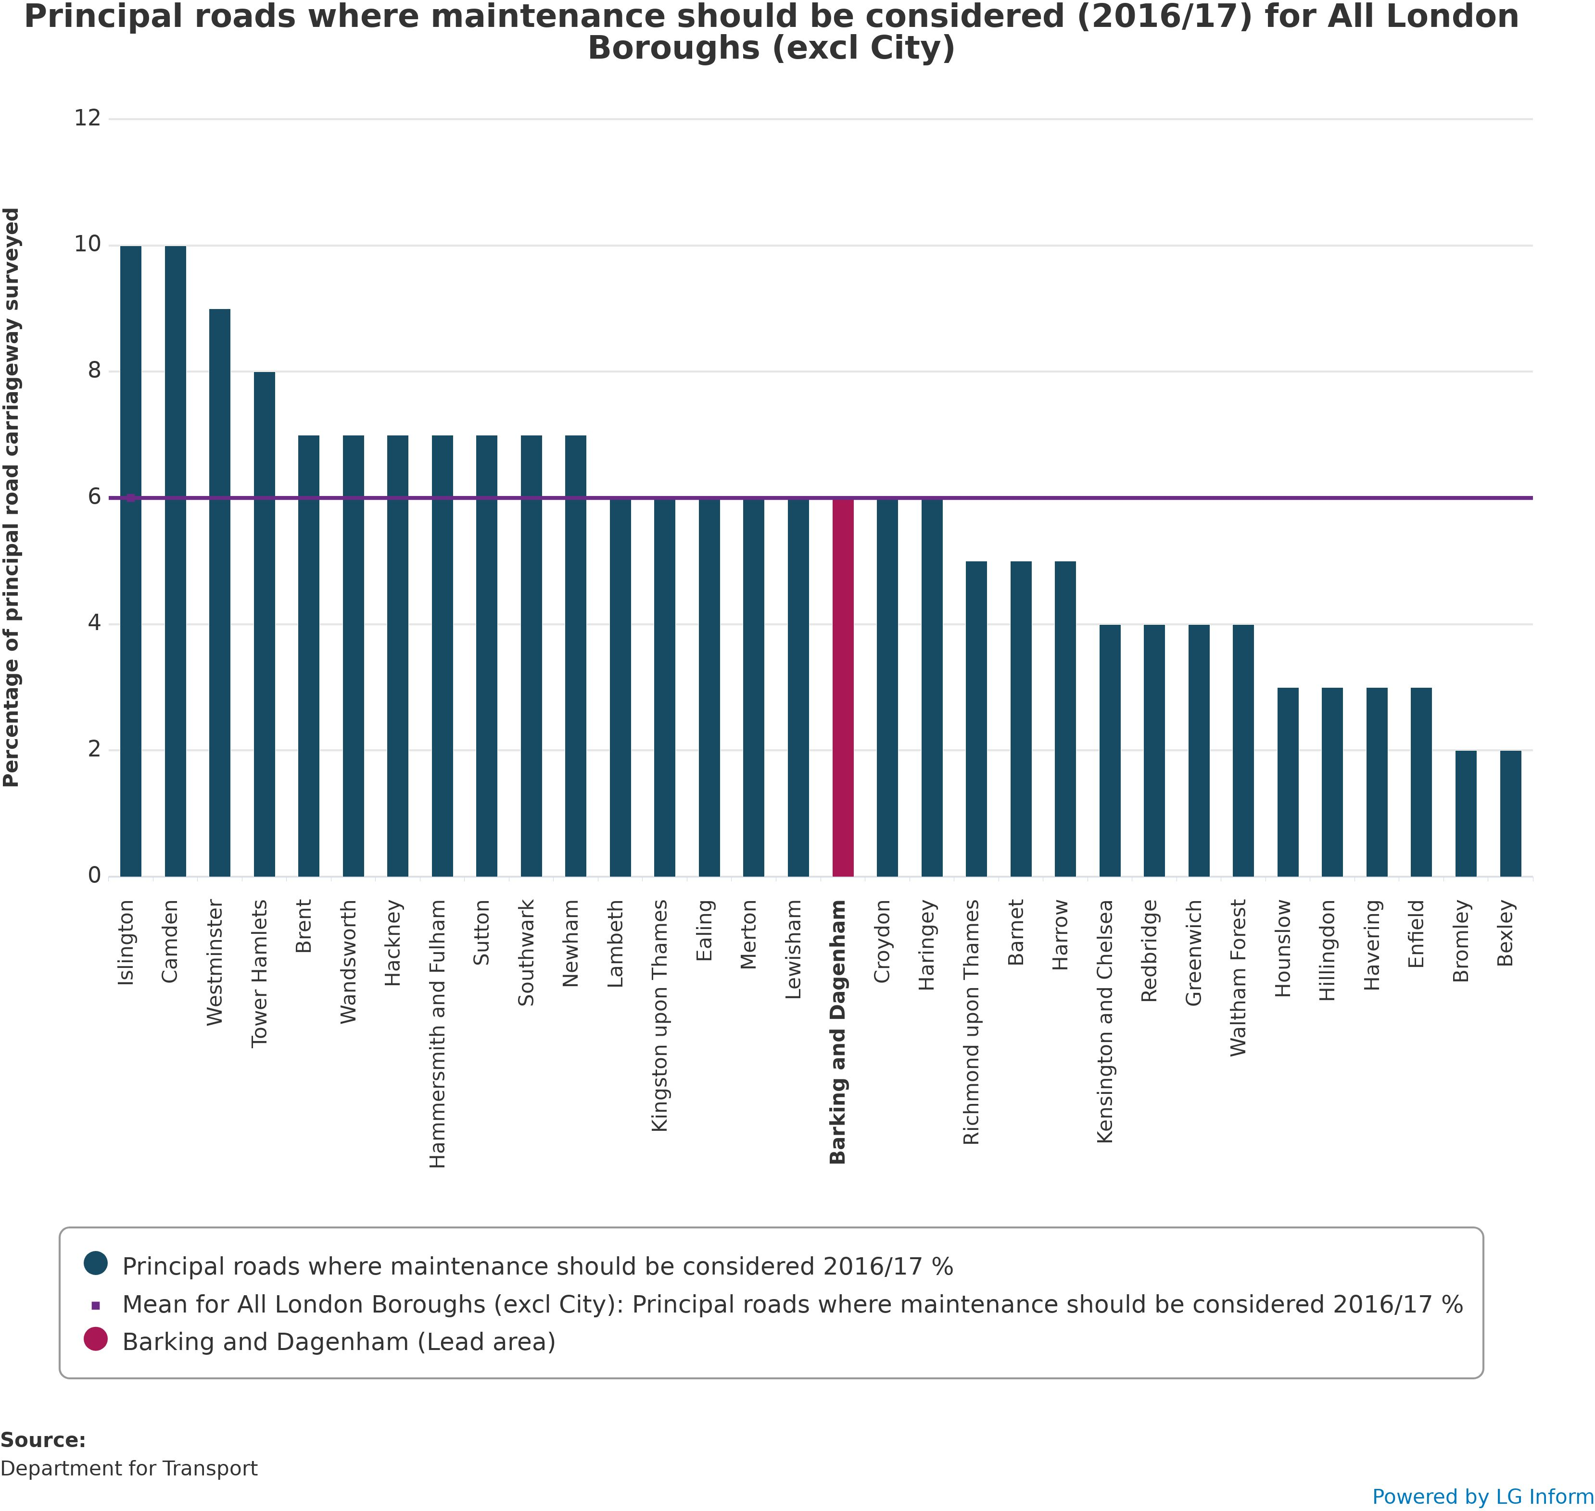
ROADS AND PAVEMENTS in more depth…
Data from the Department of Transport shows that the principal roads within the borough where maintenance should be considered is the same as the London average

Slide 20
73% agree different ethnic backgrounds get on well
In line with 2017 (72%), 2016 (72%) and 2015 (74%) despite all the political uncertainty
Residents who are 25-34, Black and Muslim are more likely to agree
Over 55s, retired and White British are less likely to agree
QE1 To what extent do you agree or disagree that this local area is a place where people from different backgrounds get on well together?
Unweighted Base: 973 respondents
Notes:
More likely to agree
25-34 (79% vs 73%)
Black ethnic group (83% vs 73%)
Muslim (83% vs 73%)
Less likely to agree
Over 55s (67% vs 73%)
Retired (66% vs 73%)
White British ethnic group (63% vs 73%)

Slide 21
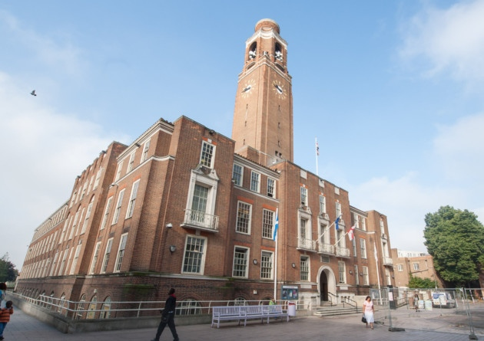
Half are satisfied with way the local Council runs things
52% are satisfied – lower than 2015 (65%), 2016 (57%) and 2017 (58%)
Also lower than the national average (60%)
More likely to be satisfied:
Over 55s
Retired
Social renters
Less likely to be satisfied:
35-54s
Working
White British
White British were also less likely to be satisfied in 2017
QB2. Overall how satisfied or dissatisfied are you with the way Barking and Dagenham Council runs things?
Unweighted Base: 997 respondents
Notes:
More likely to be satisfied:
Over 55s (57% vs 52%)
Retired (62%) vs 52%)
Social renters (57% vs 52%)
Less likely to be satisfied:
35-54s (47% vs 52%)
Working (46% vs 52%)
White British (48% vs 52%)

Slide 22
Three fifths think B&D Council is doing a good job
All have decreased when compared with last year
Largest decreases for…
Acts on concerns of local residents (-9%)
Is making local area a better place to live (-7%)
It is easy to access council services (-7%)
QC1. Here are some things that other people have said about their council. To what extent do each of these statements apply to Barking and Dagenham Council?
Unweighted Base: Base size varies (989 – 933 respondents)

Slide 23
Rating of key local services
These services have an impact on how people feel about the area
When compared with last year, all have fallen other than collection of council tax (+3%) and street lighting (+1%)
Biggest drop is repair of roads and pavements (-8%) and policing (-7%)
QB9. What is your opinion of…?
Unweighted Base: Base size varies

Slide 24
Service users rate services more highly than all residents
Most services are rated more highly by users than by residents as a whole
But parking services is an exception (-1%)
The largest differences are for housing benefit service (+16%) and libraries (+14%)
QB9. What is your opinion of…?
QB10 Which of the following services do you or other members of your household use nowadays?
Unweighted Base: Base size varies

Slide 25
Decline in user satisfaction with all education services
Satisfaction with nursery education has returned to 2016 levels after a high in 2017
Satisfaction with adult and primary education has dropped slightly, whilst secondary education has fallen by 4 percentage points
BUT…almost 90% of LBBD’s schools were rated as good or outstanding by OFSTED
QB9. What is your opinion of…?
QB10 Which of the following services do you or other members of your household use nowadays?
Unweighted Base: Base size varies

Slide 26
Proportion feeling well informed
Around half (52%) feel B&D Council keeps them well informed about the services and benefits it provides
A fall when compared with 2017 (58%), but similar to 2016 (55%) and 2015 (54%)
Also significantly lower than the National survey (58%)
White British, those with a disability and living in Dagenham are less likely to feel well informed
White British were also less likely to be satisfied in 2017
QD3 How well informed do you think B&D Council keeps residents about the services and benefits it provides?
Unweighted Base: 976 All respondents
Notes:
Less likely to feel well informed:
White British (48% vs 52%)
Disability (44% vs 52%)
Living in Dagenham (47% vs 52%)

Slide 27
Vast majority have access to the internet
91% have access to the internet (-2%)
82% have access via a smartphone/tablet (-4%)
78% have access on a desktop/laptop at home (-4%)
33% visit the website at least once a month (-1%)
48% visit less often (+3%)
Over 75 is where usage falls away sharply
33% receive the fortnightly newsletter “One Borough” (+1%)
GDPR has had an impact on LBBD’s “One Borough” mailing list – have had to build it up again
Two fifths (42%) of those that don’t receive the newsletter would like to
QD1 Do you have access to the internet? Unweighted Base: 998 respondents
QD2. How often do you visit B&D Council’s website? Unweighted Base: 866 respondents
QD4a. B&D Council sends out a fortnightly email newsletter to residents called “One Borough” do you receive it? Would you like to?
Unweighted Base: 836 respondents

Slide 28
A key attraction for new residents is affordable housing
Why move here?
Those living in B&D for less than 5 years were asked why they moved to the area.
Affordable housing was also the top response last year.
QB3. How long have you lived in Barking and Dagenham? Unweighted Base: 1,000 respondents
QB4: Why did you choose to live in Barking & Dagenham? Unweighted Base: 73 respondents

Slide 29
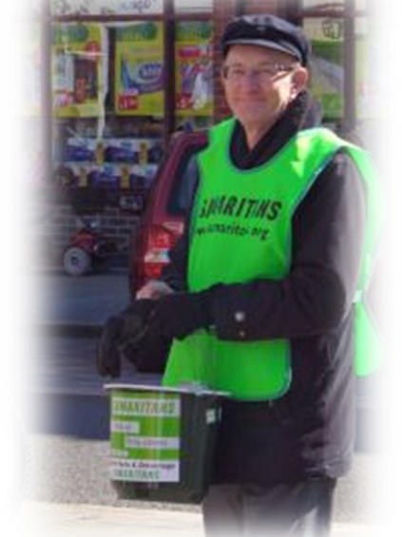
1 in 5 attended a Summer of Festivals event
22% attended a Summer of Festivals event with those aged 35 – 54 and households with children most likely to have attended
However, the proportion of residents saying they were unaware of the events has increased
34% were unaware this year compared with 26% in 2017
Over 9 in 10 (94%) want similar events next year
21% have formally volunteered in the last 12 months
Similar to 2017 (23%), 2016 (22%) and 2015 (24%)
Retired, those without children and Family Basics mosaic group are less likely to have volunteered
QF1a have you given any unpaid help to any group(s), club(s) or organisations(s) in the last 12 months? Unweighted Base: 999 respondents
QF2 Did you attend any of the Summer of Festival events? Unweighted Base: 996 respondents
QF3. Do you think the Council should consider running similar events next year? Unweighted Base: 935 respondents
Notes:
More likely to have attended an event
35-54 (26% vs 22%)
Households with children (29% vs 22%)
Less likely to have volunteered
Retired (16% vs 21%)
Those without children (18% vs 21%)
Family Basics mosaic group (17% vs 21%)

Slide 30
CONCLUSIONS

Slide 31
Conclusions
Satisfaction with area as place to live is declining
Particularly among the White British population
Crime, affordable housing, roads and pavements and litter/dirt are main areas of concern
Growing concern with crime and conditions of roads and pavements
Litter/dirt in the street and lack of jobs are less of a concern
Important to bear in mind these are perceptions and the reality is slightly different…
People are feeling increasingly unsafe, especially after dark
Increased concern around drugs, litter and fly tipping
But abandoned/burnt out cars and vandalism is becoming less of a problem
Half are satisfied with the Council – significantly lower than last year
3 in 5 think the Council is doing a good job
Downward trend on “acts on concerns of local residents”, “making local area a better place to live” and “easy to access council services”
Services
Service users rate services more highly than all residents
Education services have seen a decline in user satisfaction
Communication
Half feel well informed – lower than 2017
Online access continues to be high

Slide 32
Key perceptions for consideration
Safety after dark – year on year decline highlights this as a major problem
Crime – clearly area of most concern and has seen an year on year increase over the last 4 years
Targeted work on anti-social behaviour, especially people using or dealing drugs, may help people feel safer
Need to understand the decline in education services satisfaction
Continue to increase reach and quality of communication
Continue with Summer events – popular with almost everyone

Slide 33
Thank you
Any questions?
This study was conducted in accordance with ISO 20252:2012

