Slide 1
Capacity issues, unmet needs and Joy Marketplace
LBBD Link Workers December 2023

Slide 2
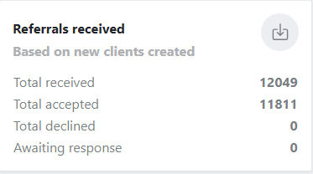
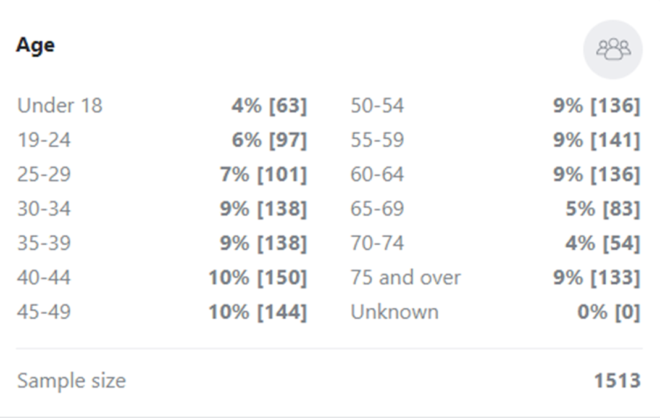
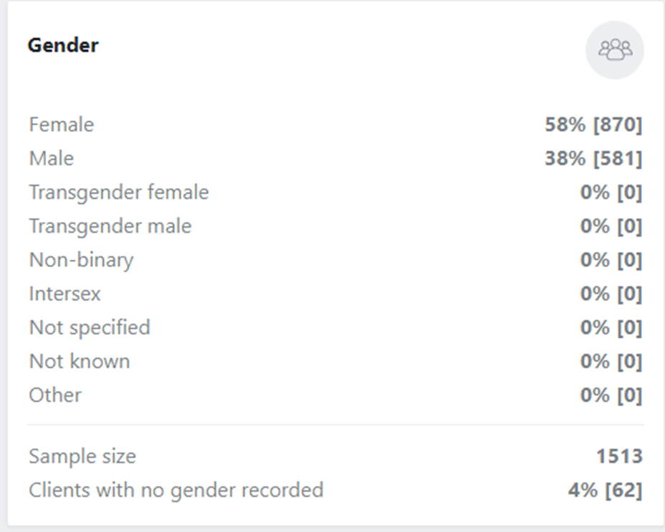
Who uses social prescribing

Slide 3
Who uses social prescribing

Slide 4
Demographics April - Sep 2023
Notes:
Practise list
sizes as at end of March 2022
Total referrals include referrals for healthy lifestyles programmes
SP+ shows SPLW caseloads

Slide 5
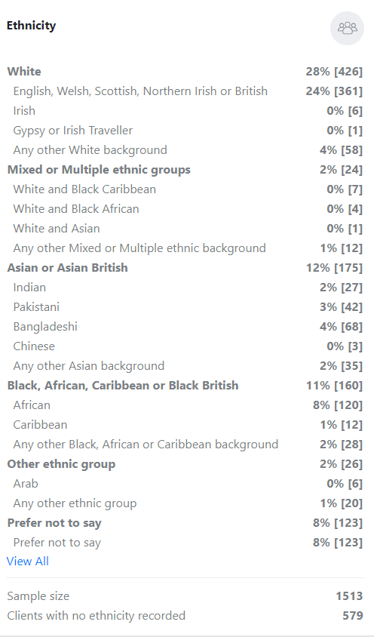

Slide 6

Core Criteria for the Community Chest Grant
1. Equality, diversity and inclusion – supporting those who are left behind or not well provided for by the current offer
2. Capacity building – strengthening your organisation’s capability to deliver support
3. Existing Health Priorities – your proposal should support and compliment local health priorities
4. Evidence – you would be required to show the impact of your work and share this with other organisation

Slide 7

LIVING WELL
Mental Health/ Social Isolation
  Befriending services
  Handholding services e.g helping people attend activities, appts, building resilience and independence
  Peer support groups e.g
  Mental health support while waiting for specialist help
  Home delivery service e.g food support/ Prescriptions/ Home library with the aim to connect the resident to an online/ community activities
  Supporting residents with NRPF status e.g language barriers, mental health, counselling, access to local services
AGING WELL
Access to Community services
  Good access to Community transport e.g Dial – a ride not always suitable/
  IAG for older people that includes Benefit checks, form filling support e.g similar to that provided by Age UK, DABD
  Digital inclusion
  Home library service/be-friending/ check –in
  Home from hospital service
  Handy person services – Volunteers?
Key Criteria: Potential activities that could support existing health priorities
Feedback from Health professionals, SPLW and Joy Data
ACROSS ALL AREAS
Community cohesion and integration support
BSL Translators – not enough available to support or free courses
Language barriers e.g interpreting /translation services – could volunteers play a role?

Slide 8

Potential activities that could support existing health priorities
Green social prescribing / Net zero- using the power of nature to improve health and wellbeing
Supporting walking and nature- based activities
Gardening e.g community gardening. Allotments
Supporting residents to access health and wellbeing services in the most efficient way
Best start in life - Young people
Mental health serviced for young people (primary & secondary age)
Weight management for young people ( 12 – 16 years old)
Youth provision in some wards across Barking and Dagenham – provision on their door- step

Slide 9


Through engaging in this funding, we have developed a greater understanding of how to use Joy and engage with link workers to help facilitate referrals. While we have not reported referrals for the youth theatre over this period, we are currently in conversation with a number of link workers, support workers, and partner organisations and will be receiving referrals from September, utilising the youth theatre as a means of improving the mental wellbeing of young participants
Green shoes Arts
Feedback from 2 of the funded organisations – IMPACT OF COMMUNITY CHEST FUNDING
The impact of the Community Chest has demonstrated, that there are opportunities to take Roding Rubbish further and become an official Community Organisation. I have met some lovely people and the funding has enabled us to have a bigger impact for the social and well- being to our volunteers. Roding Rubbish has been able to interact with schools with education about the dangers of littering to the environment. It will enable us to have better equipment, also share information about Roding Rubbish to local people. "
Roding Rubbish

Slide 10
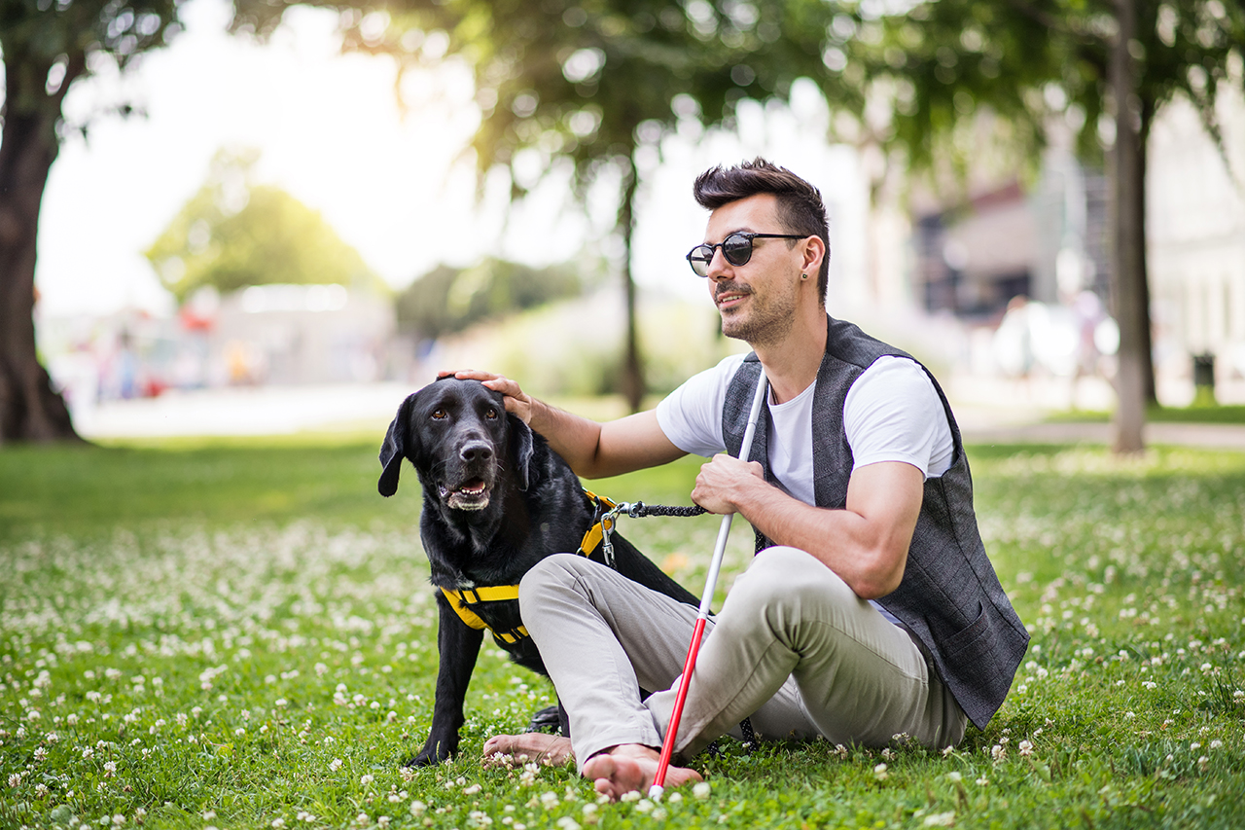
Mr Smyth joined our service at the end of last year, he is registered blind and lives alone. He was receiving weekly visits from one of our Companions. With assistance Mr Smyth was gradually growing in confidence, beginning to visit friends and local shops. In January 2023. Mr Smyth was the victim of a burglary, which understandably was a very distressing time for him and had a huge impact on his mental health. His problems continued when his insurance company asked him to list the items that had been stolen, as he is blind an impossible task.
It was at this point we received funding from the Community Chest which gave us the capacity to give additional home visits to Mr Smyth, helping him to catalogue what had been taken and to return his home to order. Now moving forward from his ordeal, with the help of his Companion he has started visiting local shops again and is showing interest in attending our groups. Our work will continue with him
Harmony House
Resident Case studies
Beneficiaries of the Community chest funding

Slide 11

"Jordan is ten years old and attends a local school. His elder step brother has attended sessions run by the Trust over several years, became a helper and assistant coach, and has recently qualified as a football referee. He is now 15 years old, regularly attends our weekly fun football sessions and is a member of our match day ball boy and girl team. Now following in his step-brother's footsteps, Jordan has attended a couple of our camps, has developed both physically and mentally. He has come out of his shell at the camps, grown in confidence and towards the very end of the season joined our ball boys and girls team, standing in for absentees.
In spite of his age, he has taken the soft skills learned at camp and applied them to his everyday life. He now also attends the weekly football sessions and will be the youngest full time matchday volunteer next season. He has learned to engage with everyone, no matter what age, and is happy to assist all others. Jordan works with all those around him, asking relevant questions and always offering to help. He is always prepared to muck in and help everyone, offering advice and assistance when needed.
Dagenham and Redbridge Community Trust
Resident case studies
Beneficiaries of the Community Chest funding

Slide 12
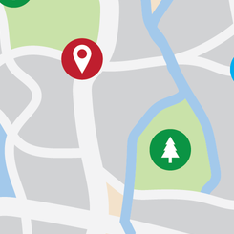


Key benefits of Joy for local organisations
Reach more people who can benefit from your support
100+ languages
Accessible for all residents
Shorter time to refer
Integrated with GP surgery software
Very simple to use
All key activities can be performed in 2-clicks directly from your email
You are in total control, manage capacity, visibility, waiting lists, referral criteria, add/remove services
Data, data, data!
Joy provides a raft of data including referral source, wellbeing improvement, key needs of the population, GP appt reduction, gaps in service provision

Slide 13
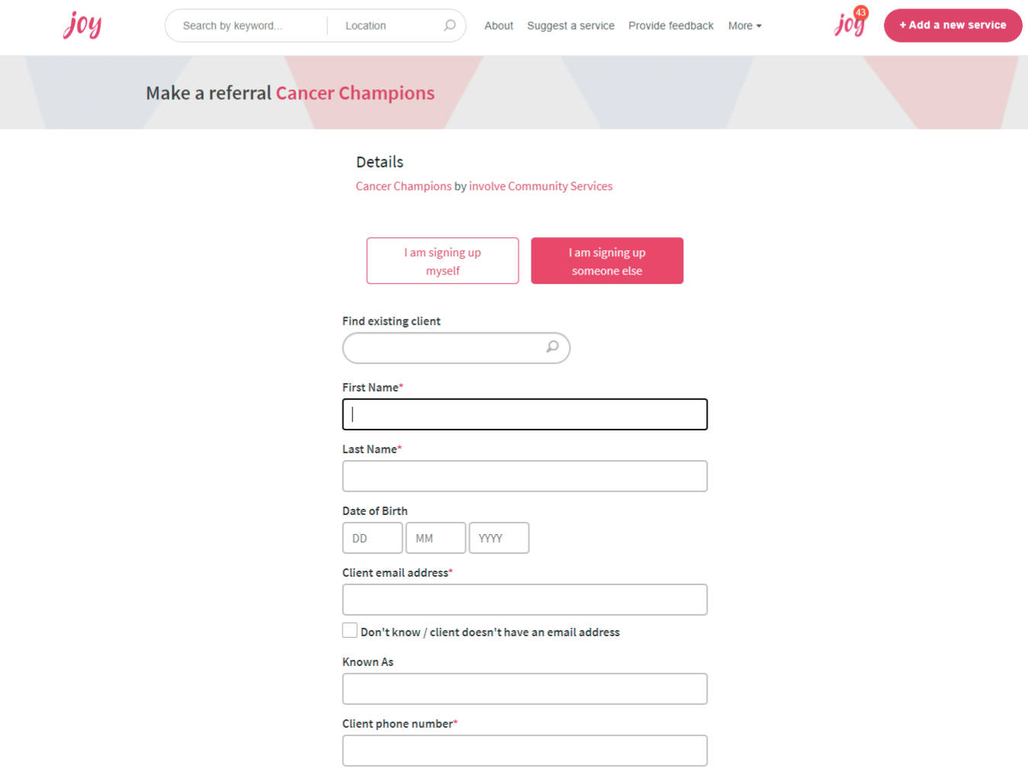
How it works: Making a referral / signpost
Find a service
Make a referral / signpost
Receive a referral
Track outcomes
Embed your referral form and eligibility criteria to Joy
Option to receive referrals via Joy (GDPR compliant)
Reduces “time to refer” to 3mins
‘Signposting only’ option
if direct referrals are not appropriate (e.g. foodbanks) then you can still be on Joy, but you won’t receive referrals

Slide 14
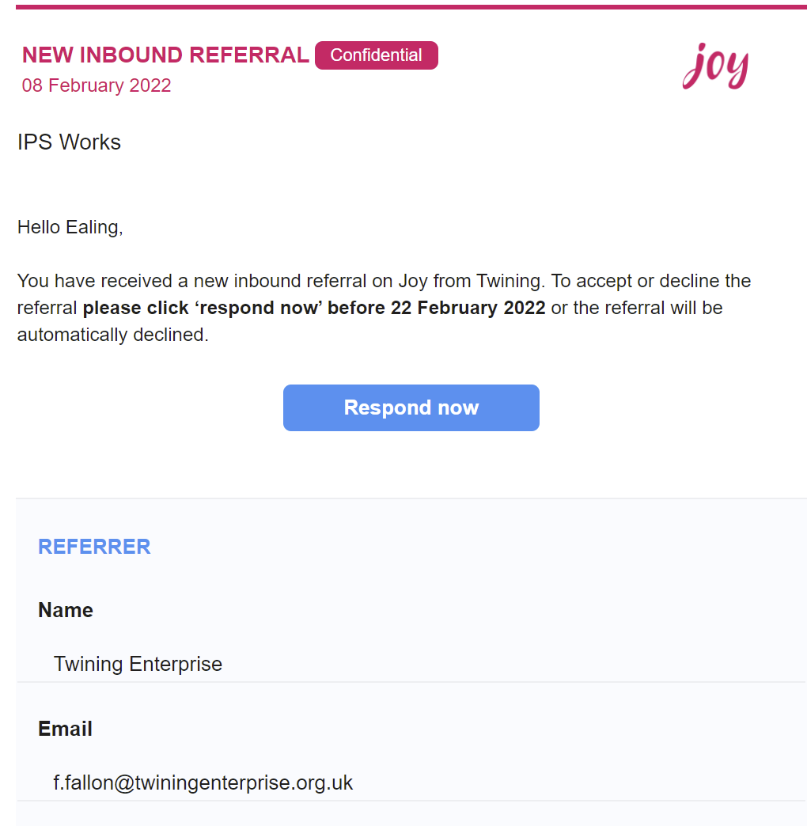
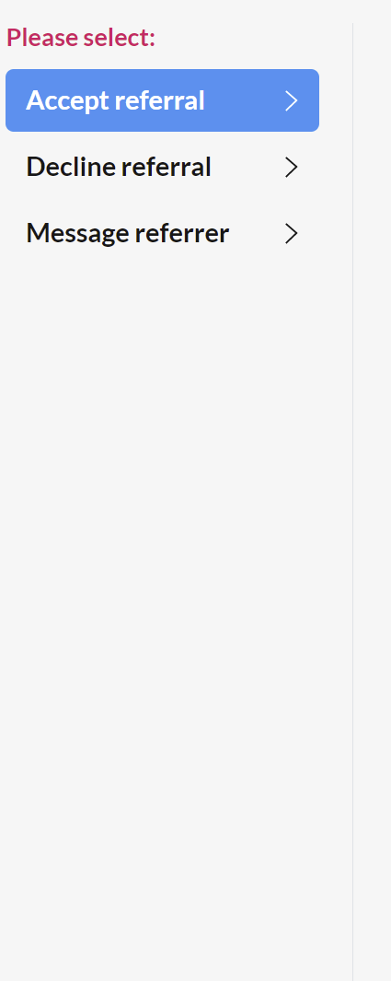
How it works: Receiving a referral/signpost
Find a service
Make a referral
Receive a referral/signpost
Track outcomes
New referrals land in your email/CRM
Accept/decline in two-clicks
Dr Hannah Middleton
Hannah.middleton@nhs.net

Slide 15
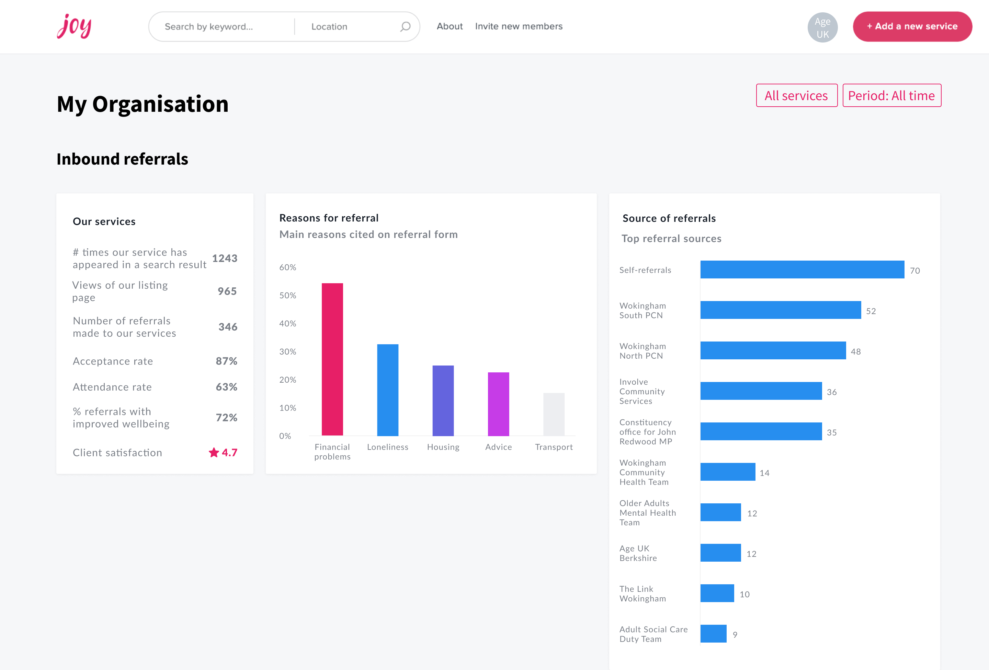
How it works: Track outcomes
Find a service
Make a referral
Receive a
referral
Track outcomes
Number of referrals broken down by source
Wellbeing improvement for clients accessing your support
GP appointment reduction
Aggregated, anonymous data

Slide 16
How to sign up to Joy
To be listed onto Joy please click the link and complete the form and we will do the rest. Sign up to Joy
If you would prefer to organise a discussion, please contact socialprescribing@lbbd.gov.uk and we can organise a further information session.

Slide 17
Myth busting/Q &A
Topics
Topics
Managing the number of referrals
Overwhelmed by referrals of those with conditions I cannot support
All my referrals would have to come via Joy ?
Difficulties with using the Joy marketplace
How do I sign up to Joy
Evaluation at the end of the Project- what is required
What support would be available?
Who manages the fund in Barking and Dagenham?
I cannot meet the criteria required to access the funding
Opportunities for collaboration

