Slide 1
Leaseholder Conference
1st November 2025

Slide 2
Opening Remarks Councillor Twomey

Slide 3
Agenda (1)
Time | Item | Duration | Presented by
10.00am | Welcome | 10 minutes | Councillor Twomey
10:10am | Leasehold Reform | 40 minutes | Led by LEASE
10:50am | Q & A | 10 minutes | All
11:00am | Services Charges 101 | 40 minutes | Led by LEASE
11:40am | Q and A | 10 minutes | ALL
11.50am | LBBD Leaseholders update | 20 minutes | Sales and Leasehold Team, LBBD

Slide 4
Agenda (2)
Time | Item | Duration | Presented by
12.05 pm | Q & A | 10 minutes | ALL
12:15 pm | Enforcement | 20 minutes | Karen Bryan and Charlotte Seymour
12.30pm | Comfort/Networking break | 20 minutes | ALL
12:50pm | Building Safety Act and how this affects leaseholders | 30 minutes | John Forbes
13.20pm | Q&A | 10 minutes | ALL
13:30pm | MP remarks | 10 minutes | Margaret Mullane MP for Dagenham & Rainham –
13:40-14:00pm | Close of the conference | 20 minutes | Councillor Worby

Slide 5

Leasehold Advisory Service (LEASE)
Presentation
By Nicholas Kissen, Senior Legal Adviser

Slide 6
Agenda
Brief history
Mission
Services
Leasehold and Commonhold reform
Q&A

Slide 7
Brief history
1994: ‘Leasehold Enfranchisement Advisory Service’.
1996: ‘Leasehold Advisory Service (LEASE)’.
2005: LEASE an ENDPB.
2013: LEASE service for Park Home owners
2017: LEASE service for leaseholders in buildings with unsafe cladding and other fire safety issues.

Slide 8
Mission
“To provide the information, advice and support that leaseholders and park home owners need to resolve their issues and to secure good outcomes wherever possible when in dispute with third parties.”

Slide 9
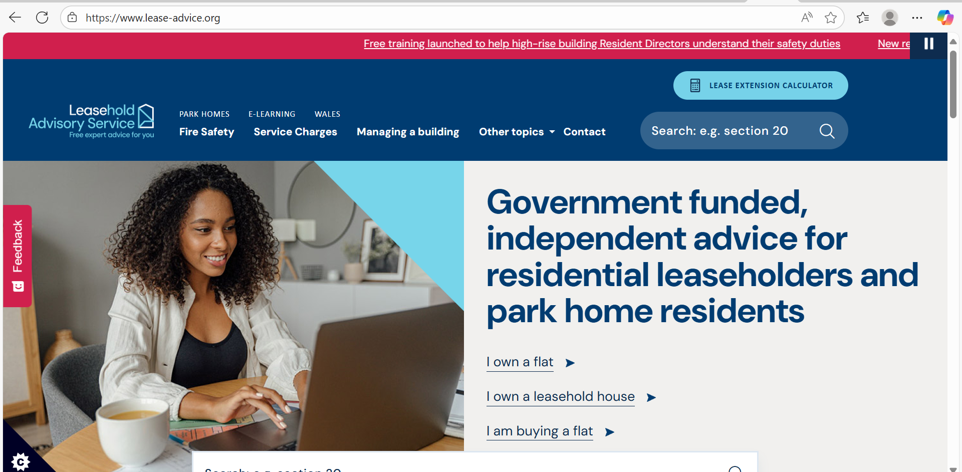

Slide 10
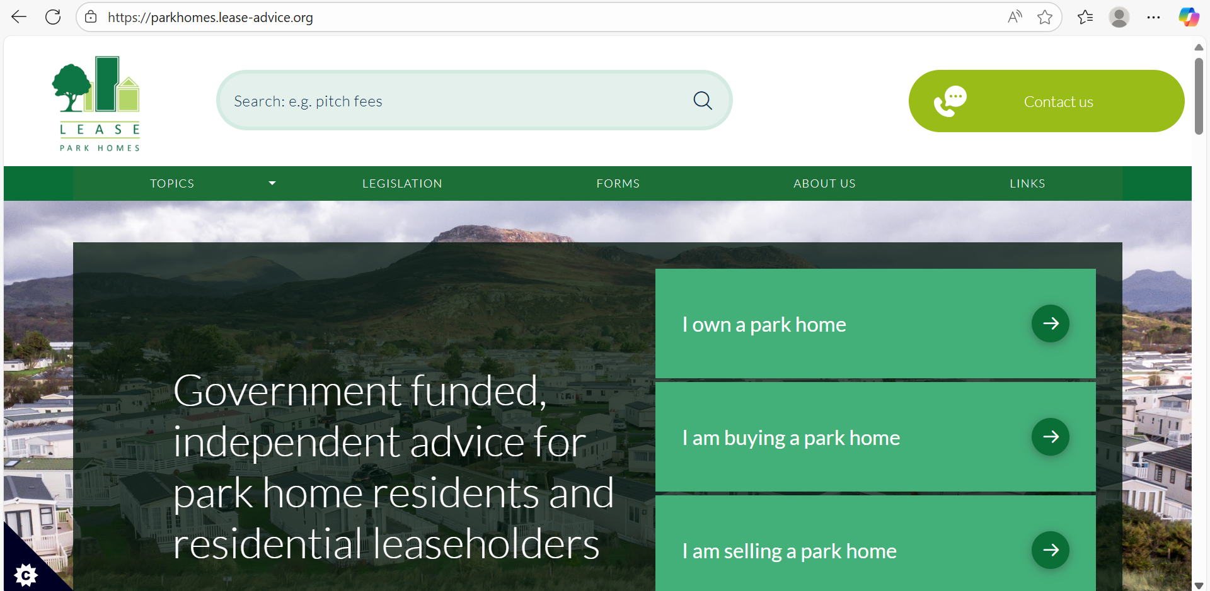

Slide 11
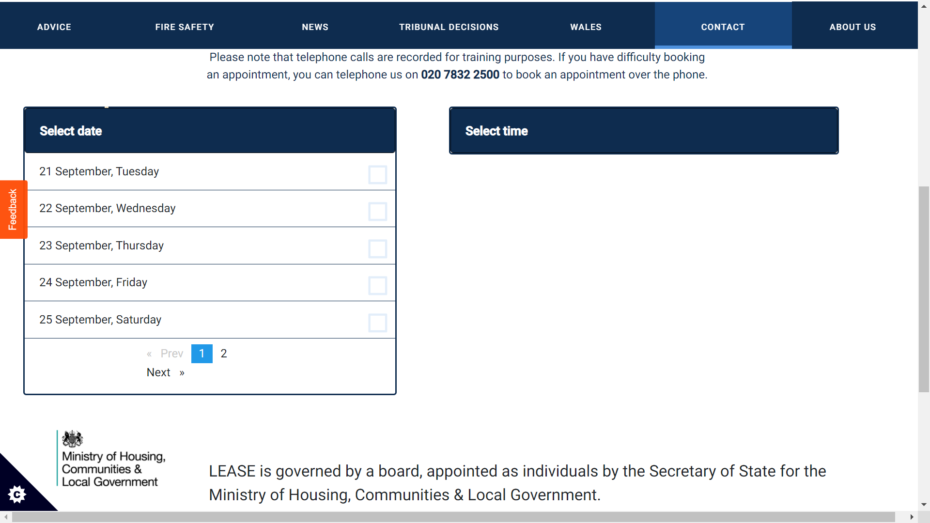

Slide 12
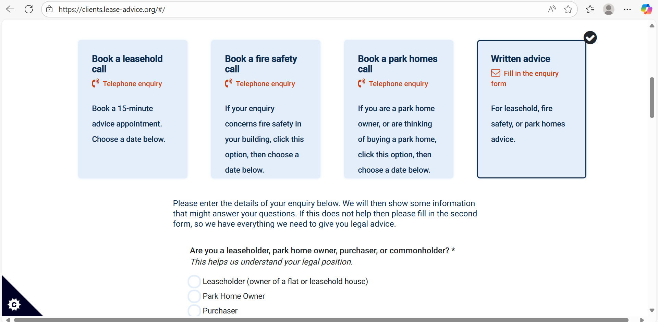

Slide 13
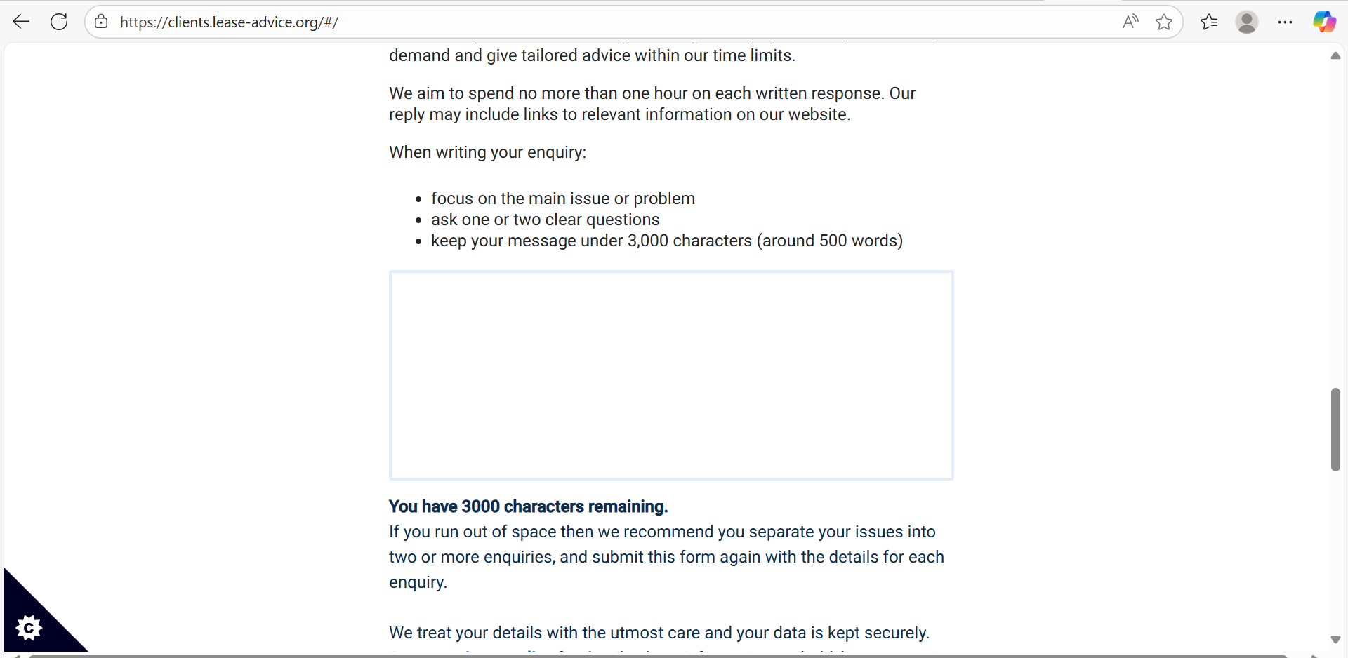

Slide 14
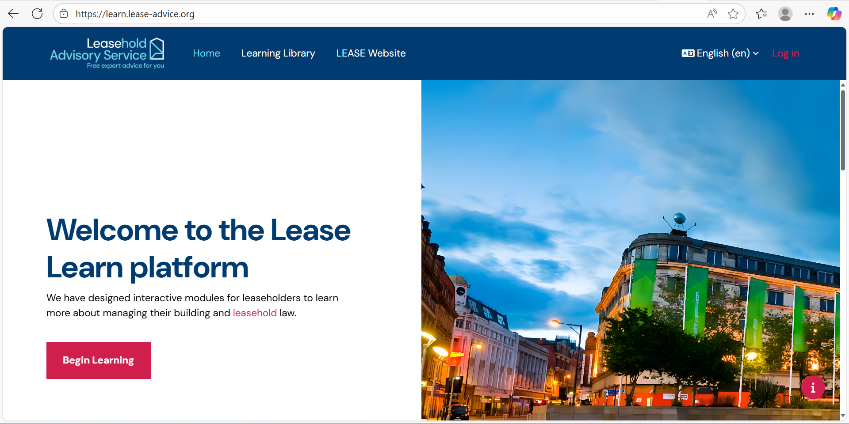

Slide 15
Leasehold and Commonhold reform
The Leasehold Reform (Ground Rent) Act 2022
Commenced on 30 June 2022
Retirement Properties commenced on 1 April 2023
Ground rents in new leases set at nil/peppercorn
Freeholders banned from charging administration charges for collecting a peppercorn rent
Fines from £500 up to £30k where ground rent is charged in contravention of legislation.
Statutory lease extensions for houses and flats exempt from the Act.
Ground rent can remain in a voluntary extension to the end of the term.

Slide 16
Leasehold and Commonhold reform
Leasehold and Freehold Reform Act 2024
Received Royal Assent on 24 May 2024 (most provisions yet to commence)
Make it easier and cheaper for leaseholders to buy their freeholds
Lease extension to 990 years for houses and flats at peppercorn ground rent
Online calculator to determine cost of new lease/freehold purchase
Remove marriage value from the cost of valuing short leases (term under 80 years)
Remove two-year ownership requirement for lease extension-took effect on 31 January 2025.
Remove the requirement for leaseholders to pay freeholder’s costs in an enfranchisement claim.

Slide 17
Leasehold and Commonhold reform
Leasehold and Freehold Reform Act 2024
Provide greater transparency over service charge information by creating a standardised format.
Remove barriers for leaseholders to challenge unreasonable service charges at FTT.
End excessive buildings insurance commissions for freeholders and managing agents
Replace commission with transparent and fair handling fees
Make it easier for leaseholders to appoint managing agents of their
choice.
Grant freehold home owners on private and mixed tenure estates the same redress rights as leaseholders to challenge charges.
Freeholders to belong to a redress scheme
Increase floor space from 25% to 50% for non-residential areas in mixed use buildings to enable RTM/collective enfranchisement take up-in force since 3rd March 2025.

Slide 18
Leasehold and Commonhold reform
Leasehold and Freehold Reform Act 2024
Make buying/selling leasehold property quicker and easier by setting a maximum time and fee for property information.
Ban the sale of new leasehold houses, save in exceptional circumstances
Every house in England and Wales will be freehold.

Slide 19
Questions?
The Leasehold Advisory Service
020 7832 2500
info@lease-advice.org
www.lease-advice.org
2 Marsham Street, London SW1P 4DP
Currently working remotely

Slide 20
Q&A

Slide 21
Service charges

Slide 22

Service charge
Are the charges payable under the lease?
Are the charges reasonable?
- Section 27A LTA 1985
Have relevant statutory requirements been complied with?

Slide 23
The lease
The landlord seeks to recover money from the tenant. On ordinary principles there must be clear terms in the contractual provisions said to entitle him to do so”
-Gilje v.Charlgrove Securities Limited [2002] 1 EGLR 41

Slide 24
General rule
IF IT IS NOT IN THE LEASE YOU CANNOT RECOVER IT

Slide 25
The service charge demand
•Sections 47 Landlord and Tenant Act 1987
•Landlord’s name and address (and service address) on demand
•Immediate landlord
•Sum demanded not due until compliance
•Must be accompanied by the summary of rights and obligations
•Prescribed form and content
•May withhold payment in absence of summary

Slide 26
Construction of lease
•Improvements vs. repairs
•Inherent defects
•Management costs
•Agent’s fees
•Legal costs
•Section 20C LTA 1985
•Sinking fund
•Sweeper clause

Slide 27
Recovery under lease
•Advance payments?
•When due?
•Certification?
•By whom ?
•Audited accounts required ?
•Inspection of documents?
•Sections 21 and 22 of Landlord and Tenant Act 1985.

Slide 28
Information
•Tenant entitled to written summary of costs-one month
•Section 21
•Tenant entitled to inspect supporting documentation-two months
•Section 22
•Failure to comply without reasonable excuse is summary offence punishable with a fine

Slide 29
Proportion
•Governed by lease terms
•Equal proportion
•Fixed % based on floor area
•Rateable value
•“fair” or “reasonable” proportions

Slide 30
Historic service charges
•Limitation Act 1980
•Rent
•6 years
•Service charges
•12 years

Slide 31
Historic service charges
•S20B of the Landlord and Tenant Act 1985
•
•Not payable if “incurred” 18 months before either service charge demand or written notification
•
•“Incurred” =receipt/payment of invoice
Om Property Management Limited v.Burr [2013] EWCA Civ 479

Slide 32
Holding service charges
•Held on Trust
•Section 42 of the Landlord and Tenant Act 1987

Slide 33
Reasonableness
•Section 19 Landlord and Tenant Act 1985
•Service charges only payable to the extent that
•Costs were “reasonably incurred”
•Works and services of a reasonable standard

Slide 34
Reasonableness
•Section 19(2)
•Where service charge payable before cost incurred, amount demanded must be reasonable;
•After cost is incurred, relevant adjustment must be made

Slide 35
Reasonableness
•Was the landlord’s decision a reasonable one?
•Did it fall within a “reasonable range” of possible decisions?
•All about the decision making process
•Tendering for works/services
•Testing market periodically to ensure VFM

Slide 36
Historic neglect
•Daejan Properties v.Griffin[2014] UKUT 0206 (LC)
•But for a failure by landlord/manager to repair on time part/whole repair cost would have been avoided
•Tenant can set off damages for repairing covenant breach against service charges

Slide 37
Tribunal jurisdiction
•S27A of the LTA 1985
•Payability/reasonableness of service charges
•Watch out for costs
•Rule 13
•Through the service charges
•Section 20C Order?
•Against the leaseholder
•Freeholders of 69 Marina v.Oram[2011] EWCA Civ 1258
•Barrett v.Robinson[2014] UKUT 0322 (LC)
•Order made under Paragraph 5A of Schedule 11 to the 2002 Act.

Slide 38
Remedies & recovery
•County Court
•Tribunal
•Forfeiture
•Writing to mortgage lender?

Slide 39
The Leasehold and Freehold Reform Act 2022
24 May 2024-ROYAL ASSENT
Last statute passed before dissolution of Parliament for the 2024 General Election
Apart from certain provisions that have come into force already we are awaiting further commencement legislation
None of the main provisions relating to service charges have so far come into force.
None of the main provisions relating to service charges have so far come into force.

Slide 40
Service charges-LFRA changes
Demands must contain specified content, and be in a prescribed form and provided to leaseholders in a specified manner
To be devised in secondary legislation/Regulations
Landlords under duty to provide within six months of the end of the 12-month accounting period
Written statement of account in a specified form and manner.
Written report about the statement prepared by a qualified accountant in accordance with specified standards for financial information and containing accountant’s statement in a specified form and manner that the report faithfully represents what it purports to represent

Slide 41
Service charges-LFRA changes
Landlords obliged to provide on request adequate invoices, receipts, or other documents to the accountant to help prepare the report.
Landlords obliged to provide annual report within one month of the end of the 12-month accounting period in respect of service charges etc. arising in that period
Information required, form or report and manner of providing it can be specified in regulations

Slide 42
Provision of information about service charges- LFRA changes
Services
Repairs
Maintenance
Insurance
Management of the dwellings

Slide 43
Enforcement of landlord’s obligations relating to service charges
Civil enforcement-Application to the First-tier Tribunal (Property Chamber)
Order for specific performance e.g.
Provision of service charge demand
Provision of annual report
Damages up to £5,000

Slide 44
MHCLG consultation on service charges
Published on 4th July 2025
Includes implementation of parts of LFRA 2024
Year end report
Year end accounts
Prescribed demands

Slide 45
MHCLG consultation on service charges
Implementation of potential new law
Mandatory reserve funds
Reforming major works
Protecting leaseholders’ money
Electronic service of documents

Slide 46
MHCLG consultation on service charges
Deadline to respond was 26th September 2025
MHCLG will consider responses and final policy and then proceed to draft legislation
LEASE did respond-https://www.lease-advice.org/news-item/lease-response-to-the-mhclg-consultation-paper/

Slide 47
Questions

Slide 48
Q&A

Slide 49

Leaseholders Update - Sales and Leasehold Team, LBBD

Slide 50

Context -LBBD's housing stock
Overview of Housing Stock within LBBD
LBBD has a total housing stock of = 19,978
Dates of construction; range between 1920-1935
1970’s – flats in blocks, high rises
Most new-builds provide affordable housing and in recent years developed by Be First Ltd and managed by Reside
56 high rise blocks containing 2,948 flats
4,208 leaseholders of which
live in the property: 2,394 (57%)
Non-resident : 1,814 (43%)

Slide 51
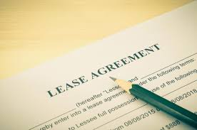
What we do
The Sales and Leasehold Management team operate within LBBD Housing, Education and Communities (HEC) division. We are responsible for managing and supporting leasehold properties, as well as facilitating home ownership through statutory schemes.
Our core responsibilities include:
Right to Buy (RTB)
Leasehold Management
Service Charges:
Section 20 Consultation

Slide 52

Meet the RTB Team
The Right to Buy section processes applications from eligible council tenants who wish to purchase their homes. The team guide residents through the statutory process, ensuring legal compliance and supporting tenants from initial enquiry to completion of the sale.
Following the Government’s announcement in October 2024, which saw the discount entitlement reduced. There was a huge surge in applications during the 3-week period,
Over 1000 applications were submitted.
This had an impact on the rest of the team and affected response times.
We are still working through some application and have around 800 active applications
The Team
Senior Sales and Leasehold Manager - Katja Bhatti
2 x Sales & Leasehold Management Officers
1 x Assistant RTB Officer

Slide 53

Meet the Leasehold Management Team
The Leasehold Management team
Key Activities
Responding to leaseholder enquiries
Ensuring compliance with lease terms.
Processing pre-sale enquiries and notices of assignment
Handling permission to alter applications
Monitoring and reviewing sub-let data
Progress to date
Review of processes has improved response times to leaseholder queries
Improved communication and ways of working between teams resulting in clear lines of responsibility.
Finalised Leasehold Management policy document
Increased visibility of subletting activity on Open Housing
Formally recognised Saddler House Committee Residents Association
The Team
Senior Sales and Leasehold Management Officers Jumoke Ezomo, Sunita Sunassee
4 x Sales and Leasehold Management Officers
1 x Leasehold Management Support Officer

Slide 54
Leasehold Management Sublet and Assignment Data
Financial Year | Sublet processed | Assignments
2022-2023 | 24 | 107
2023-2024 | 63 | 139
2024-2025 | 59 | 161
2025-2026 (Partial) | 294 | 78

Slide 55

Meet the Service Charge Team
Service Charge Team
Key Activities
Issuing annual service charge statements including reserve fund balances
Responding to service charge queries and disputes
Coordinating with internal teams to gather cost data .
Progress to date
Actual statements were sent out within legislative timescale
Actively working through leaseholder queries
Service charge policy has been finalised.
The Team
Service Charge Manager – Brett Mayne
1 x Service Charge Finance Officer

Slide 56

Meet the Service Charge/Section 20 Team
Section 20 Consultation team
The Section 20 Consultation Team manages the formal consultation process required for major works and long-term agreements affecting leaseholders.
Key Activities
Issuing Section 20 Consultation notices.
Liaising with contractors and internal teams to plan and deliver works
Responding to observations and objections received during consultation periods.
Progress to date
About to commence consultation with leaseholders on improved payment options to support leaseholders who maybe be facing affordability issues.
Developed clearer processes and templates.
Collaborating with external contractors for improved communication and presentation of final account data.
Improved internal workflows to ensure timelines are adhered to and key responsibility points.
Introducing a new covenant to the lease where leaseholders will have to provide gas and electrical certificates.
The Team
Service Charge Manager – Brett Mayne
2 x Service Charge/Section 20 Consultation Officers

Slide 57

What we are working on
Here’s what else we are working on:
Produced a new leasehold newsletter to promote engagement and communication
New Leasehold Handbook, providing clear guidance for leaseholders
Introducing a new leasehold management framework
Currently reviewing and changing leasehold related webpages to reflect changes in legislation and processes
Working with colleagues to develop clear processes and templates for handling permission to alter request.
Working with compliance to ensure leasehold properties meet all regulatory standards and safety requirements
Challenges
Ensuring consistent and accurate data across our systems
Aligning processes across departments for smoother service delivery
Managing leaseholder’s expectation when dealing with complex enquiries.

Slide 58


Anti- Social Behaviour Team
Antisocial Behaviour Manager
7 x ASB Officers
1X Business Support Officer Apprentice

Slide 59

Antisocial Behaviour Intervention/Enforcement
Engage
Support
Advise
Signpost
ENFORCE

Slide 60
Responsible For
Social Housing
Private Rented Sector – License to rent
Temporary Accommodation - License
Hostel Accommodation - License

Slide 61
Private Sector Housing Landlords Licensing Scheme
If ASB is reported about a resident living in a licensed property, the ASB team will write to the landlord and ask the Landlord to address this.
If the Landlord fails to address this and the ASB continues, after a full investigation, a CPW is served on the resident. The Landlord is notified of this action/enforcement.
Should there be further reports of ASB, following investigation, a CPN will be served on the resident, and our PSH team will be notified. They may use the tools available to them in line with the license.

Slide 62
ASB Crime and Policing Act 2014
Anti-Social Behaviour – Definition
Conduct that HAS caused, or is LIKELY to cause, harassment, alarm or distress to ANY person
Conduct CAPABLE of causing nuisance or annoyance to a person in relation to that person’s OCCUPATION of RESIDENTIAL premises
Conduct CAPABLE of causing HOUSING-RELATED nuisance or annoyance to ANY person

Slide 63
Ladder of Intervention:
Civil Route
Where the risk assessment suggests the case is low, the following steps may be taken:
Mediation - if both parties agree
Acceptable Behaviour Contracts, an informal approach to enforcement action
ASB Warning, an unofficial warning may act as an early intervention, which prevents escalating Anti-Social Behaviour
Notice of Seeking Possession Mandatory/Discretionary

Slide 64
Ladder of Intervention:
High Risk Case
Criminal Route
Community Protection Warning
Community Protection Notice
Criminal Behaviour Order
Injunction
Closure Order

Slide 65
Statistics
The Anti-Social Behaviour Team has dealt with on average 100 enquiries per month to date
The Anti-Social Behaviour Team has issued over 42 Community Protection Notices
The Anti-Social Behaviour Team has led on over 10 closure orders & partial closure orders
The Anti-Social Behaviour Team has successfully obtained a Criminal Behaviour Order and supported Police to obtain 12
The Anti-Social Behaviour Team has issued over 85 Community Protection Warnings

Slide 66
Consultation With Stakeholders
Dual diagnosis
Meet once a month along with NELFT and CGL to discuss complex cases.
Community MARAC
Is co-ordinated by Stacey Gibson and chaired by the ASB Manager and Police Inspector to discuss challenging cases.
Ward Panel Meetings
Are for the public to meet with police, Councillors, ASB officer's and other professionals.
Ending Youth gang violence
Once a month to discuss youths in a gang or on the peripheries
Monthly NELFT
Meeting is held once a month and attended by internal and external stakeholders to discuss clients with mental health issues
Criminal Behaviour Order Panel
Attended by ASB Manger to discuss conditions, positive requirements and next steps
Case Officers/SNT’s
ASB Officers meet with their respective Police SNTs to discuss issues within their allocated wards.

Slide 67
ASB in the Community
“Youths hanging around blocks”
“Individuals loitering in and around shops/stations”
“Individuals taking or dealing drugs on street corners”
Public Space Protection Orders – 4 in the borough
Heathway, Barking Town Centre, Goresbrook Broad Street
Community Safety Team/Police- working in partnership

Slide 68

Questions asb@lbbd.gov.uk
This Photo by Unknown Author is licensed under CC BY-SA

Slide 69

Break
Notes:
JK

Slide 70
Margaret Mullane MP for Dagenham & Rainham

Slide 71
Building Safety Act and how this affects leaseholders

Slide 72

Building Safety Act 2023
John Forbes
Building and fire safety Lead
CIOB.IFE.I.C.O.W

Slide 73


Agenda
Introduction
Financial Protections
Cladding
Non-Cladding
Key Provisions for Leaseholders
Impact on Leaseholders
Quotes
Summary

Slide 74
Introduction
The Building Safety Act 2023 is a significant piece of legislation in the UK aimed at enhancing the safety and accountability of building construction and management, particularly for high-risk buildings.
The Building Safety Act 2023 introduces significant changes aimed at improving building safety and protecting leaseholders from the financial burden of remediation costs for historical safety defects.

Slide 75



Non-Cladding Costs Protections also extend to certain non-cladding remediation costs, provided specific conditions are met. For non-cladding defects, qualifying leaseholders have their contributions capped and spread over 10 years. Any costs already paid since June 28, 2017, count towards this cap.
Key Provisions for Leaseholders

Slide 76

Impact on Leaseholders Key Benefits for Leaseholders Financial Relief: Contributions for non-cladding safety defects are capped, reducing the financial burden on leaseholders. Increased Security: Leaseholders are protected from unexpected large bills, providing peace of mind. Fairness and Accountability: Developers and building owners are held responsible for safety defects, promoting fairness. Legal Protection: Leaseholders are shielded from legal costs associated with pursuing remediation. Market Stability: The provisions help stabilize the property market, making it easier to buy, sell, or refinance properties.

Slide 77
Cost Savings: Leaseholders are shielded from potentially crippling bills for historical safety defects, ensuring financial stability and peace of mind. Increased Accountability: Developers and building owners are held accountable for the safety of their buildings, promoting higher standards in construction and maintenance.
Impact on Leaseholders

Slide 78
Financial Protections Leaseholders in buildings over 11 meters or five storeys are protected from the costs of remediating historical safety defects. Developers and building owners associated with the original construction are responsible for covering these costs.
Key Provisions for Leaseholders

Slide 79
Cladding Qualifying leaseholders are exempt from all costs related to unsafe cladding systems.
Key Provisions for Leaseholders

Slide 80
Case Study: A Residential Block in Manchester: Background: A residential block in Manchester had multiple safety issues, including faulty fire doors and inadequate fire stopping. Impact: The leaseholders were initially asked to pay for the repairs. However, with the new provisions, the building owner, who had a net worth exceeding £2 million, was required to cover the costs. This significantly reduced the financial pressure on the leaseholders, who only had to contribute a small, capped amount.
Key Provisions for Leaseholders

Slide 81
Impact on Leaseholders Discussion Prompts How have these provisions impacted your financial planning as a leaseholder? Have you experienced any changes in your building’s management or maintenance since these provisions were introduced? What further improvements would you like to see in leaseholder protections? For More Information For more details or assistance, visit the GOV.UK website or contact the Leasehold Advisory Service at 020 7832 2500. Feel free to share your thoughts or ask any questions!

Slide 82
Quotes “Safety should never be a priority. It should be a precondition.” – Paul O’Neill “The greatest responsibility of a leader is to give the people in your span of care a grounded sense of hope for the future.” – Bob Chapman1

Slide 83




Summary
The Building Safety Act 2023 represents a significant step forward in protecting leaseholders and ensuring building safety. By shifting the financial burden to those responsible for building defects, the Act aims to create a safer and fairer housing market.

Slide 84

Thank you
John Forbes
Building & Fire Safety Lead
Housing, Environment, and Communities (HEC)
“Building resilient, sustainable, and inclusive communities.”
lbbd.gov.uk | facebook.com/barkinganddagenham | @lbbdcouncil

Slide 85
Q&A

Slide 86
Closing Remarks Councillor Worby

